Slide 1
Pathways Learning Experience
Ken Cawley, PID
District 4 Pathways
Chief Ambassador

Slide 2
Agenda
Overview of Pathways Program
Comparison of Pathways to Legacy C&L Program
Getting Started
Base Camp Manager Role
Pathways Resources
Notes:
For most clubs, the vice president education (VPE) will assume the role of Base Camp manager. The Base Camp manager helps facilitate your progress by verifying your education, approving requests and more. In the event a VPE isn’t able to perform these duties, or if a club does not have a VPE, the Base Camp manager responsibilities will be fulfilled by the club president or club secretary. The central responsibilities of the Base Camp manager include:
Approving speeches outside the club
Verifying level completion
Tracking member progress
Verifying project completion for members using printed materials

Slide 3
- Club meetings do not change in any way
- DTM does not go away
- Legacy C&L program available until June 30, 2020
- Choose between online and printed materials
- Cost is minimal – far less than current program
Notes:
C&L: $115. Pathways online: $25. print: $75
Your regular membership dues cover the cost of your first path, however, if you choose the printed materials option for your path, there is a $25 printing fee. The cost for an additional path is $20, and if you elect to work in printed materials, the $25 printing fee also applies.
If you are working in one path and decide to switch to another path, you do not need to pay an additional $20 as long as you make the exchange within 30 days of the original purchase. The $25 fee you pay for a path with printed materials is not refundable. Remember: you can always print out copies of the Pathways materials on your own, at no charge. If you are enrolled in Pathways online, you can print out any of the materials on Base Camp.
You are eligible for a maximum of two free paths if you belong to more than one club. To qualify for a second free path, you must already be a member of multiple clubs when Pathways rolls out in your region. Joining additional clubs after Pathways is available to you will not qualify you for a second free path.

Slide 4
Overview of the Pathways Program

Slide 5
Core Competencies of Toastmasters Learning
Public Speaking
Interpersonal Communication
Strategic Leadership
Leading and Managing
Building Confidence
Notes:
From all of the research, review, analysis and feedback, the Pathways team identified the five core competencies one can learn by participating in the education program.
These competencies are the platform on which the program is being built.
Public Speaking Public speaking builds members’ confidence in delivering both prepared and impromptu speeches in the Toastmasters club environment as well as their personal and professional lives. Through practice, peer evaluation and educational tools, members learn how to present their messages effectively, concisely and professionally.
Interpersonal Communication Interpersonal communication builds members’ confidence in communicating with others, whether verbally, non-verbally, in writing or via electronic methods. Members learn how to build relationships, resolve conflict and communicate well with others.
Leading Strategically This is the ability to see the big picture and have the ideas and vision to do things better, whether it’s to build a more supportive club environment, lead a team, or attract and retain more members. The Toastmasters strategic leader has a vision that is both attainable and inspiring. He or she is able to bring about positive changes by inspiring others to get involved and help.)
Leading and Managing (There are different skill sets needed for both of these roles. Within the Toastmasters organization of clubs, areas, divisions and districts, managing deals mostly with planning, organizing and facilitating specific tasks, such as the club treasurer managing the club’s budget. Leading deals with people, whether they are individuals or groups.
Building Confidence Obviously confidence can’t be taught. Through self-reflection and evaluation, members learn to acknowledge their flaws and embrace their capacity for self-improvement. By learning how to set goals and meet them, they gain confidence in their own knowledge, skills and abilities.

Slide 6
Disciplines Established from Combination of Core Competencies
Public Speaking and Management
Public Speaking and Strategic Leadership
Interpersonal Communication and Management
Interpersonal Communication and Strategic Leadership
Public Speaking and Interpersonal Communication

Slide 7
Paths for Learning
Motivational Strategies
Presentation Mastery
Leadership Development
Innovative Planning
Visionary Communication
Strategic Relationships
Dynamic Leadership
Persuasive Influence
Effective Coaching
Team Collaboration
Notes:
You start by choosing from 10 distinct learning paths that are based on five core competencies:
Public Speaking
Interpersonal Communication
Strategic Leadership
Management
Building Confidence
Each path is designed to help you achieve the last competency, which cannot be taught: confidence. One path, Presentation Mastery, focuses solely on public speaking skills and building confidence in your abilities.
Public speaking is an important component of the other nine paths as well. It’s a skill you’ll be practicing no matter which path you choose. In fact, each path requires you to give a minimum of 15 prepared speeches.
The nine other paths also focus on a combination of the other four core competencies. You have the flexibility to choose to pursue any of these paths.
If you choose to access Pathways using Base Camp, you will take an online assessment of your skills, interests and goals. Once you’re finished, the assessment will recommend the three paths that best match your responses. If you don’t want to work in a recommended path, you may select whichever path you prefer.
Dynamic Leadership helps you build your skills as a strategic leader and conflict resolver. You’ll focus on facilitating change as well as on public speaking.
Effective Coaching helps you build your skills as a positive communicator, leader and coach. You will focus on interpersonal communication and developing strong public speaking skills.
Innovative Planning helps you build your skills as a public speaker, leader and project manager. You will focus on strategies for creating innovative solutions as well as on public speaking.
Leadership Development helps you build your skills as an effective communicator and leader. You will focus on developing and implementing a plan, leading a team and public speaking.
Motivational Strategies helps you build your skills as a powerful and effective communicator. You will focus on building connections with others, leading small groups and public speaking.
Persuasive Influence helps you build your skills as an innovative communicator and leader. You will focus on developing leadership skills to use in complex situations and public speaking.
Presentation Mastery helps you build your skills as an accomplished public speaker. You will focus on your connection with audience members and effective public speaking techniques.
Strategic Relationships helps you build your skills as a leader in communication. You will focus on building personal and professional connections with a variety of people and public speaking.
Team Collaboration helps you build your skills as a collaborative leader. You will focus on interpersonal communication, collaborating with a team and public speaking.
Visionary Communication helps you build your skills as a strategic communicator and leader. You will focus on communicating information and plans to a group as well as public speaking.

Slide 8
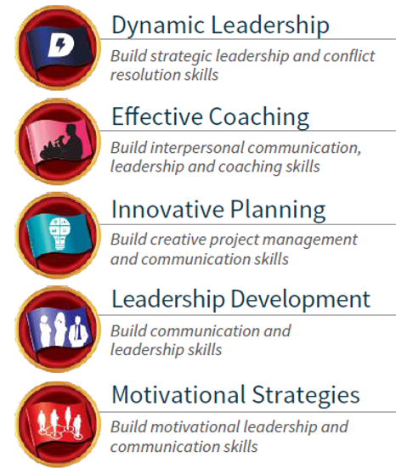
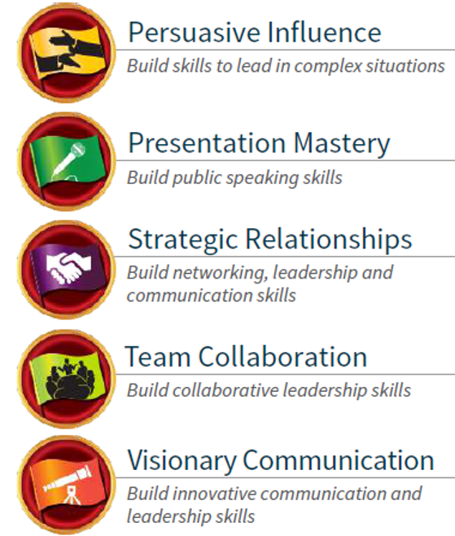
Paths and Core Competencies
1
2
3
5
1
3
2
5
1
2
4
5
1
5
1
4
2
5
1
2
3
5
1
2
4
5
1
4
2
5
1
2
3
5
1
3
2
5
PUBLIC
SPEAKING
INTERPERSONAL
COMMUNICATION
STRATEGIC
LEADERSHIP
MANAGEMENT
CONFIDENCE
1
2
3
4
5
Notes:
Here we see examples of how each of the Paths tie back to the Core Competencies.

Slide 9
Pathways Levels
Level 1
Level 2
Level 3
Level 4
Level 5
Mastering Fundamentals
Learning Your Style
Increasing Knowledge
Building Skills
Demonstrating Expertise
Notes:
Each path is divided into five levels that build in complexity. The levels help you build on and apply what you have learned.
Every path has required and elective projects. Path recognition is achieved when a member completes 14 projects across all 5 levels—a combination of 10 required projects and 4 elective projects chosen from a comprehensive list covering a variety of subjects. Each project includes at least one speech. Though members are required to complete 4 elective projects, they have the option to complete as many as they would like.

Slide 10
Level 2
Level 1
Mastering Fundamentals
Complete three projects below (all Paths)
Ice Breaker
Evaluation and Feedback
Researching and Presenting
Notes:
LEVEL 1: Master the Fundamentals. Develop or enhance your understanding of the fundamentals needed to be a successful public speaker and evaluator. You’ll focus on speech writing and basic speech delivery, as well as receiving, applying and delivering feedback.

Slide 11
Level 2
Level 2
Learning Your Style
Introduction to Toastmasters Mentoring
And complete three of the projects below based on Path selected
Understanding Your Leadership Style
Understanding Your Communication Style
Connect With Your Audience
Managing Time
Active Listening
Effective Body Language
Cross-Cultural Understanding
Notes:
LEVEL 2: Learning Your Style. Develop an understanding of your personal styles and preferences. You’ll have the opportunity to identify your leadership or communication styles and preferences. You will also be introduced to the basic structure of the Pathways Mentor Program.

Slide 12
Level 2
Level 3
Increasing Knowledge
Complete at least two electives plus one of projects below based on Path selected
Negotiate the Best Outcome
Present a Proposal
Planning and Implementing
Understanding Emotional Intelligence
Understanding Conflict Resolution
Persuasive Speaking
Make Connections Through Networking
Successful Collaboration
Develop a Communication Plan
Notes:
LEVEL 3: Increasing Knowledge. Begin increasing your knowledge of skills specific to your path. You’ll complete one required project and at least two elective projects that address your goals and interests through a wide variety of topics.

Slide 13
Level 2
Level 4
Building Skills
Complete at least one elective plus one of projects below based on Path selected
Manage Change
Manage Projects Successfully
Leading Your Team
Motivate Others
Leading in Difficult Situations
Managing a Difficult Audience
Public Relations Strategies
Motivate Others
Communicate Change
Notes:
LEVEL 4: Building Skills. Build the skills you need to succeed on your path. You’ll have the opportunity to explore new challenges and begin applying what you have learned. You’ll complete one required project and at least one elective project.

Slide 14
Level 2
Level 5
Demonstrating Expertise
Reflect on Your Path
Plus complete one of projects below based on Path selected
Lead in Any Situation
High Performance Leadership
Manage Successful Events
Team Building
Prepare to Speak Professionally
Leading in Your Volunteer Organization
Lead in Any Situation
Develop Your Vision
Notes:
LEVEL 5: Demonstrating Expertise. In this final level, demonstrate your expertise in the skills you have learned. You’ll have the opportunity to apply what you have learned at all levels to accomplish larger projects. You’ll complete one required project, at least one elective project and the “Reflect on Your Path” project to bring closure to your path. At the completion of this level you will become Proficient.

Slide 15
Benefits of Pathways
Tailored, self-paced learning
Customizes member experience to their needs
Flexibility to choose experience
Greater access to materials
Expanded resources
Real-world applicability
Give and receive effective, meaningful evaluations
Notes:
Tailored, self-paced learning. The Pathways experience is tailored to help members meet their personal and professional goals. Members can also move through their paths at their own rate.
Customizes member experience to their needs, whether it be public speaking, interpersonal communication, management or strategic leadership.
Flexibility to choose their own experience. The first thing a Toastmaster will do in Pathways is choose how to experience it: on Base Camp (our learning management system) or in printed materials. The objective isn’t to force anyone online, but to give members the flexibility to choose their experience.
Greater access to materials. Pathways was designed to make it easy for members to access their educational materials. By offering all paths online, a Toastmaster can work to complete projects, view additional resources and access printable versions of projects from their computer, laptop or tablet.
While it’s true that members who choose a path on Base Camp will not receive physical manuals or materials, Pathways gives you access to a richer learning experience, featuring 10 paths to choose from, over 300 real-world skills to learn and in-depth training resources to help you every step of the way. In addition, there are still costs associated with maintaining the Pathways learning experience, including software licensing, support and ongoing educational development.
Expanded learning resources. Resources such as video and digital content will reinforce learning in Pathways.
Real-world applicability. In Pathways members will develop practical leadership and communication skills, which they can apply to their lives outside of Toastmasters. Builds competencies that are translatable to real-world situations
Just as in the current educational program, evaluations will continue to be a vital element of Pathways. Let’s face it - we’ve all seen or received (and maybe given!) ineffective evaluations. Pathways raises the bar by giving evaluators clear standards.
The first page of the evaluation form gives an overview of the project objectives, with space for the evaluator to write general feedback.
The second page outlines the various skillsets that the project is intended to develop, with opportunity for the evaluator to give both a numeric score and narrative feedback.
The third page provides detailed criteria for evaluating the project.
The enhanced evaluation forms eliminate guesswork by providing both the speaker and evaluator with clear and detailed guidelines of what is expected.
One of the great benefits of Pathways is that anyone using the program can access evaluation forms for all projects, even for Paths they are not working on.
Club Benefits
Current members have many more opportunities to learn and develop
Can attract new members with what we’re offering
Can re-engage longtime or former members looking for new challenges

Slide 16
Pathways Status as of March 15
More than 45,772 members have enrolled in Pathways.
The average adoption rate is 29%.
More than 48,852 paths have been initiated.
99.5% of all users chose an online path instead of working in printed materials.
Final rollout (Regions 8 & 9) scheduled for May 15

Slide 17
Comparison to Legacy C&L Program

Slide 18
Program Comparison
Legacy C&L
With Pathways
Your club meeting has an agenda, meeting roles and speeches
You sign up for a speech and receive an evaluation |  | + | Access and store speech evaluations online
Club members support you and give feedback |  | + | Feedback is also available online through Base Camp
You receive recognition |  | + | Receive digital badges and certificates through Base Camp
The Ice Breaker is your first speech
The VPE tracks your progress
Speeches last 5-7 minutes
Learn 68 competencies |  | + | Learn more than 300 Competencies
One communication track, one leadership track |  | + | 10 different learning paths tailored to you
Notes:
Some members are concerned about how the club experience is going to change.
They love the experiential learning that exists in club meetings: giving speeches, receiving feedback from fellow club members, practicing Table Topics, serving in meeting roles. This process is what makes Toastmasters special.
I can reassure you that the club experience will not change! The structure and format of club meetings will remain---the only difference is there will be more learning opportunities and resources added to the experience.
On this slide you see a chart that compares the current education program with the Pathways learning experience.

Slide 19
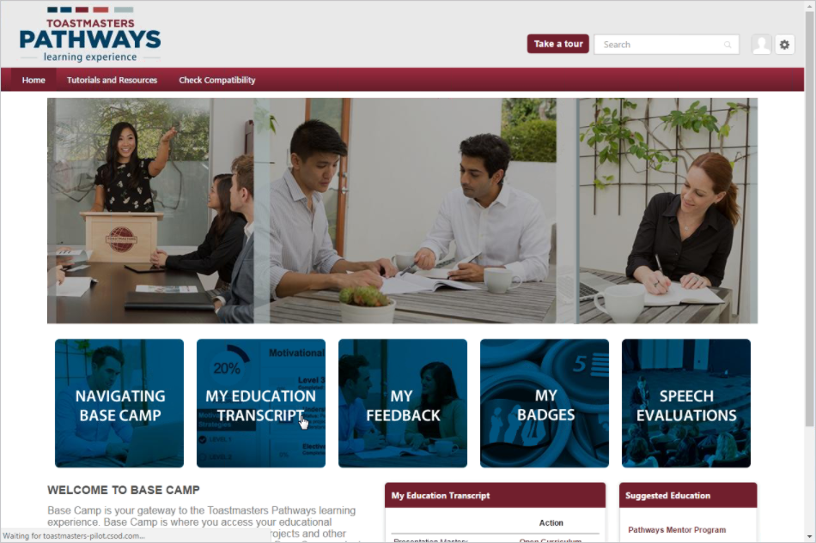
Base Camp Online Gateway to Pathways
Notes:
Base Camp is your online gateway to Pathways, where you will find everything you need on your journey. Here you can work on projects, track your progress, connect with members of your club and view badges and certificates you’ll earn along the way. Base Camp also features resources to help guide you, including videos, quizzes, interactive activities and more.
There are many elements here. First and foremost, this is the look and feel for all the pages in Pathways----you see the red bars and the different types of images that show the different aspects of the Pathways experience.
This is the configuration of our learning management system. As you can see, there are five main sections here: Navigating Base Camp, My Education Transcript, My Feedback, My Badges and Speech Evaluations. These are the areas that the Pathways team felt will be most important to members.
The system truly is a gateway to an engaging, multi-layered learning experience that will enable you to develop many new skills and maximize your growth.

Slide 20
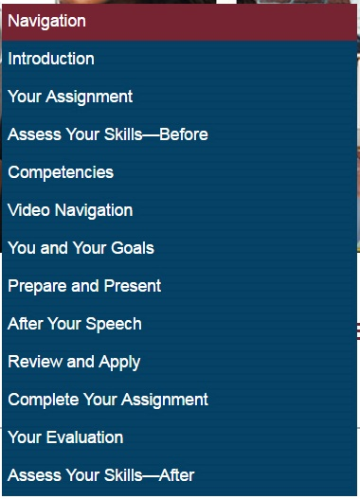
Sample a Project – Ice Breaker

Slide 21
Base Camp vs. Printed Materials
Option | Base Camp | Printed Materials
Access your path online | 
Take the Pathways Assessment | 
Number of paths available | 10 | 5
Additional fees for printed materials
Elective projects available | All | Limited
Access to learning materials after ordering | Typically within one hour | Within standard shipping time
Access to next level after completing previous level | After club officer signs off on Base Camp | After sign off and you receive next shipment
Watch educational videos in projects | 
Complete interactive activities and quizzes | 
Download and print PDF versions of projects and resources |  | Evaluation resources and select project resources
Upload and store electronic copies of your speech evaluations to access from anywhere | 

Slide 22
Path to DTM
Today
With Pathways
Competent Communicator
Advanced Communicator Bronze
Advanced Communicator Silver
Advanced Communicator Gold
Competent Leader
Advanced Leader Bronze
Advanced Leader Silver
Completion of two learning paths
Serve as club officer for 12 months
Serve as Club Mentor or Club Coach
Serve as Club Sponsor, conduct Speechcraft or Youth Leadership Program
Serve as district officer for one year
Complete capstone DTM project
Notes:
Advanced Leader Bronze includes 6 months as club officer
Advanced Leader Silver includes serve as district officer plus club coach or club mentor and HPL

Slide 23
DTM Legacy C&L Requirements
Achieved Advanced Communicator Gold (ACG)
Achieve Advanced Communicator Silver (ACS)
Complete two additional Advanced Communication manuals
Conduct a Success Leadership, Success Communication or Youth Leadership program.
Coach a new member with his/her first three speeches.
Achieve Advanced Leader Silver (ALS)
Achieve Advanced Leader Bronze (ALB)
Serve as district officer (July-June requirement)
Mythili Prabhu (IPDD) mythili.toastmasters@gmail.com
Complete the High Performance Leadership program
Serve as Club Sponsor, Club Mentor or Club Coach
Pavan Datla, Club Growth Director growth@d101tm.org
Notes:
Success Leadership 1 to 3 hours
Success Communication 2-8 (16) hours
YLP Multiple month commitment

Slide 24
DCP Education Goals
Legacy C&L Program
With Pathways
Two CC awards | Four Level 1's
Two mores CCs | Two Level 2's
One ACB, ACS, or ACG award | Two More Level 2's
One more ACB, ACS, or ACG award | Two Level 3's
One CL, ALB, or ALS award | One Level 4
One more CL, ALB, or ALS award | One Level 5
Transition DCP Education Goals
Select 6 of the above 12 goals
Notes:
One potential obstacle to the success of Pathways is confusion with changes to the Distinguished Club Program. So let’s go over that.
The DCP will be adjusted to accommodate the rollout of Pathways and the two years it runs concurrently with the current education program.
The graphic here shows you how this will work. Once Pathways rolls out in your district, clubs may meet up to six of the 12 educational goals listed as part of their recognition achievement in the Distinguished Club Program. The left column has the DCP goals for the current program, while the right column shows the Pathways DCP goals. Club members may complete any of the available goals.
Just a reminder: Even though the six goals in Pathways function the same as the six goals in the current DCP, they are not equivalent. The two education programs are structured differently, so it’s impossible to achieve parity regarding the educational goals.
This DCP transition program encourages members to begin their journeys in Pathways while still achieving Distinguished statuses in clubs.
VPEs need to enter Level as award in Club Central (many believe that approving the completion in Pathways is sufficient to count toward the DCP)

Slide 25
Base Camp Manager Role

Slide 26
Central Responsibilities
Verifying level completion
Tracking member progress
Verifying project completion for members using printed materials
Approving speeches outside the club
Notes:
For most clubs, the vice president education (VPE) will assume the role of Base Camp manager. The Base Camp manager helps facilitate your progress by verifying your education, approving requests and more. In the event a VPE isn’t able to perform these duties, or if a club does not have a VPE, the Base Camp manager responsibilities will be fulfilled by the club president or club secretary. The central responsibilities of the Base Camp manager include:
Approving speeches outside the club
Verifying level completion
Tracking member progress
Verifying project completion for members using printed materials

Slide 27
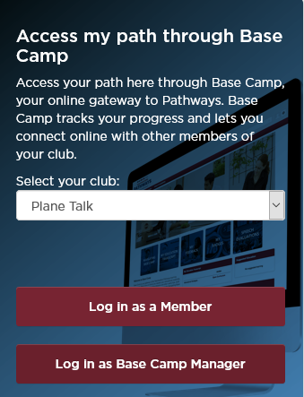
Verifying Level Completion
Non-Manager
Notes:
Create a login and password at https://www.toastmasters.org/ and bookmark the site.
Log in and also Go to Base Camp from the main Pathways dropdown menu.
Click on Login as Base Camp Manager.
If the Base Camp Manager login does not appear, you may not be registered with Toastmasters International as a manager. Ensure that your club has updated the club officers list with you as VP Education or a one of the backup roles, President or Secretary.
Click on Pending Requests from the page that appears.

Slide 28
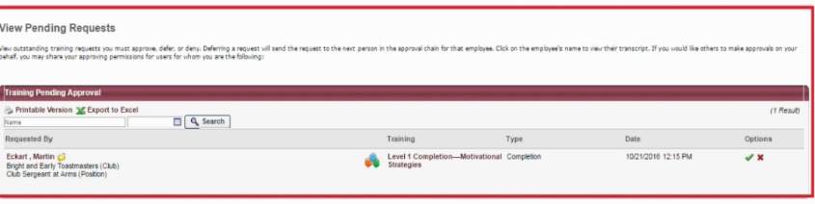
Verifying Level Completion (cont.)
Notes:
You will see any member pending requests. To approve, after checking the member’s paperwork, select the green checkmark.

Slide 29
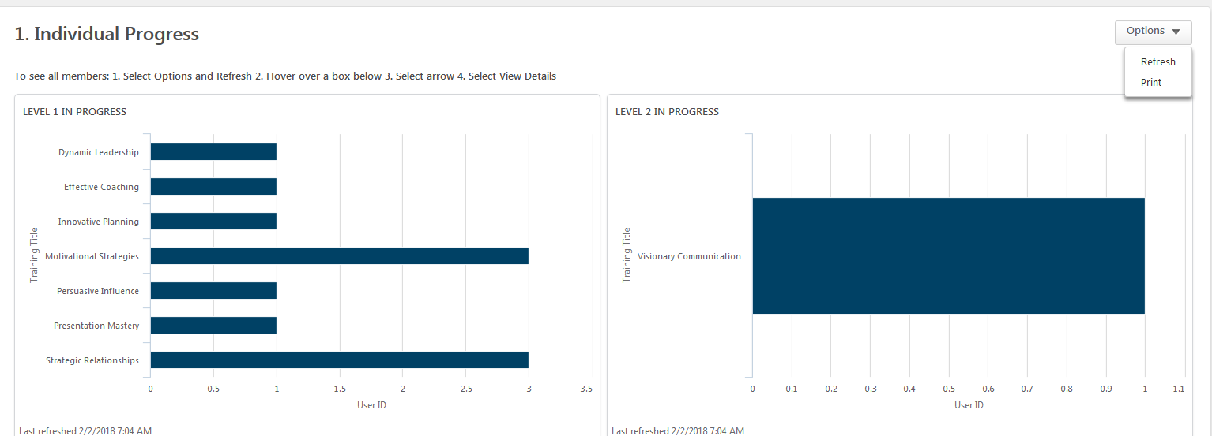
Track Member Progress
1. Individual Progress
2. Path Progress
3. Path Type
4. Recently Selected…
5. External Training
Notes:
You will see any member pending requests. To approve, after checking the member’s paperwork, select the green checkmark.

Slide 30
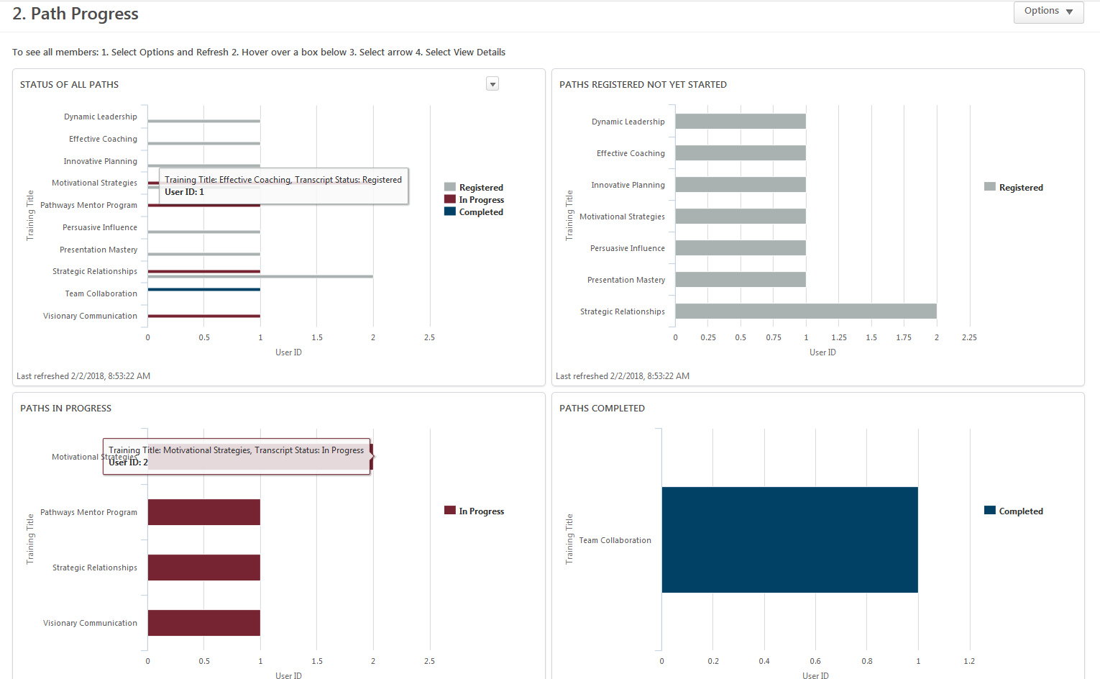
Path Progress
1. Individual Progress
2. Path Progress
3. Path Type
4. Recently Selected…
5. External Training
Notes:
There are a variety of reports which can be used to track member and club Pathways-related DCP progress if needed.

Slide 31
Base Camp Manager Tutorials
Notes:
Toastmasters has a Tutorial for almost everything

Slide 32
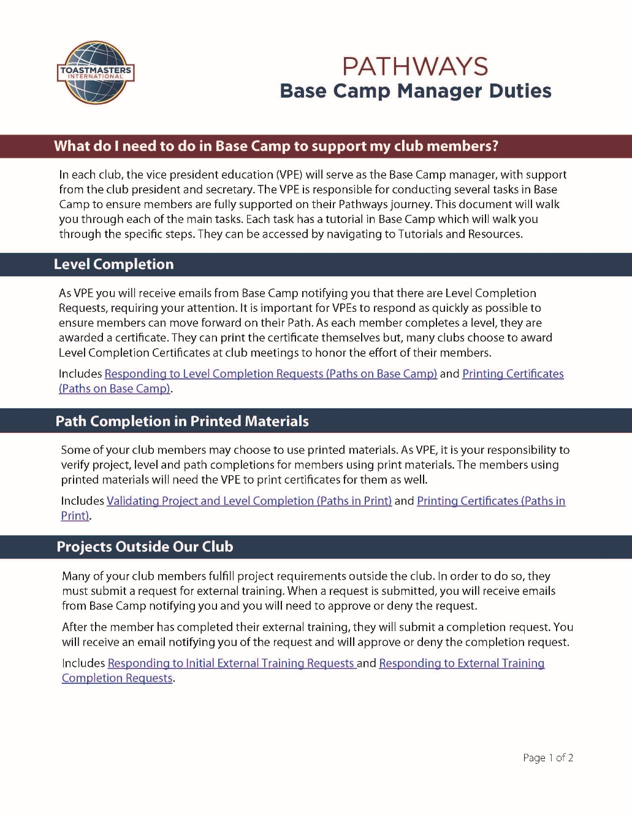

Slide 33
Base Camp Manager Duties
Responding to Level Completion Requests (Paths on Base Camp)
Printing Certificates (Paths on Base Camp)
Validating Project and Level Completion (Paths in Print)
Printing Certificates (Paths in Print)
Responding to Initial External Training Requests
Responding to External Training Completion Requests
Individual Progress Dashboard
Path Progress Dashboard
Path Type Dashboard
Recently Selected Paths Dashboard
External Training Dashboard

Slide 34
Pathways Resources

Slide 35
www.toastmasters.org/Pathways-Overview

Slide 36
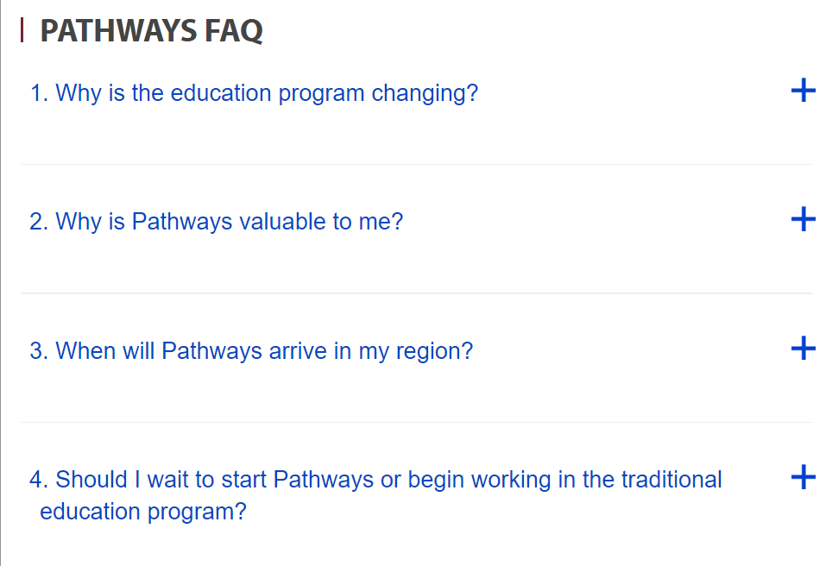
www.toastmasters.org/Education/ Pathways/FAQ

Slide 37
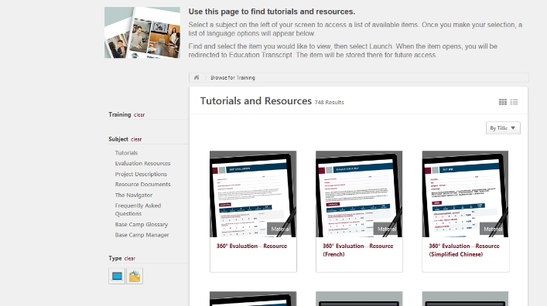
Tutorials and Resources
Notes:
Available once you have selected your Path.

Slide 38
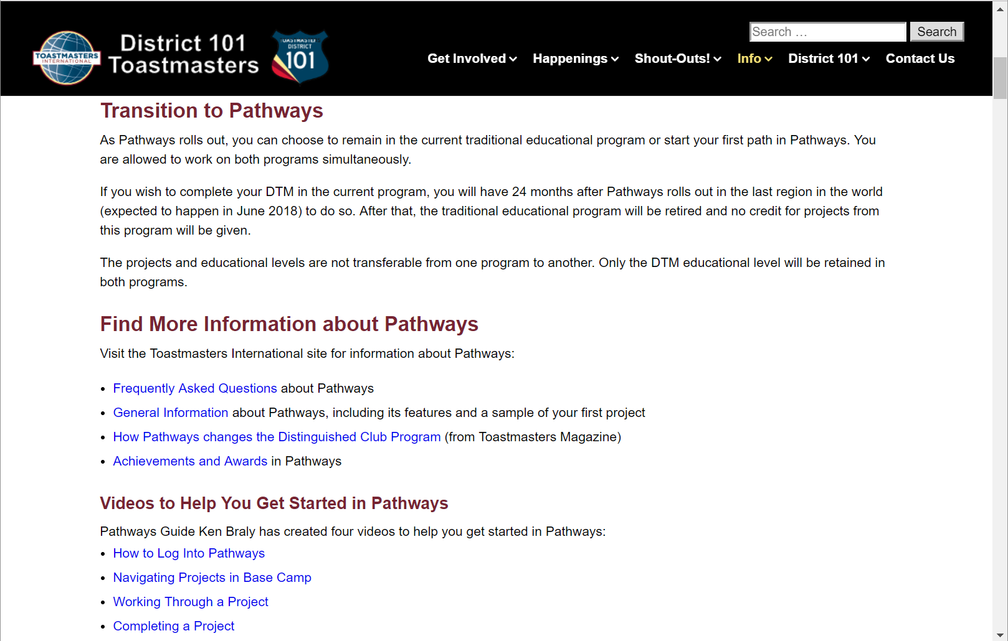
d101tm.org/pathways/

Slide 39
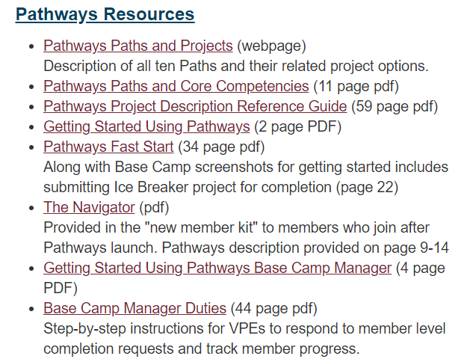
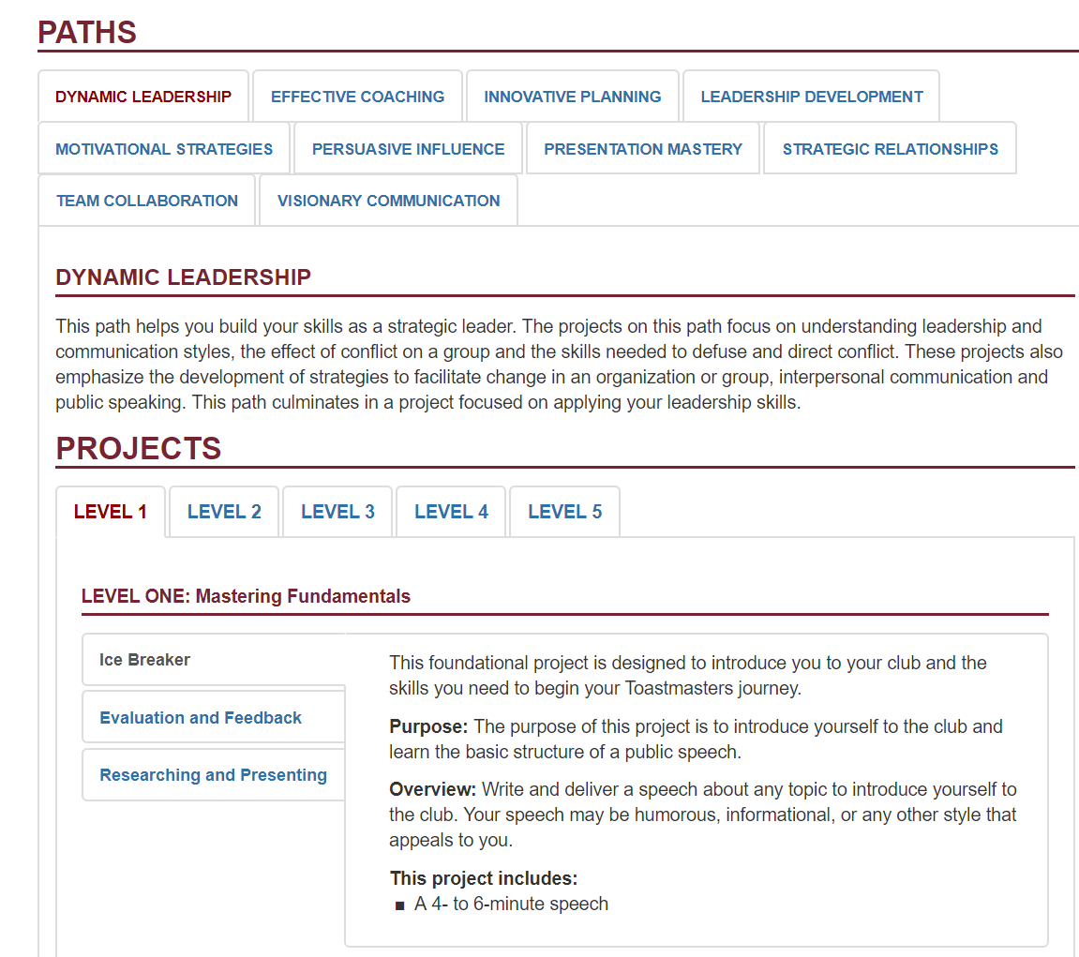
www.d4tm.org/pathways

Slide 40
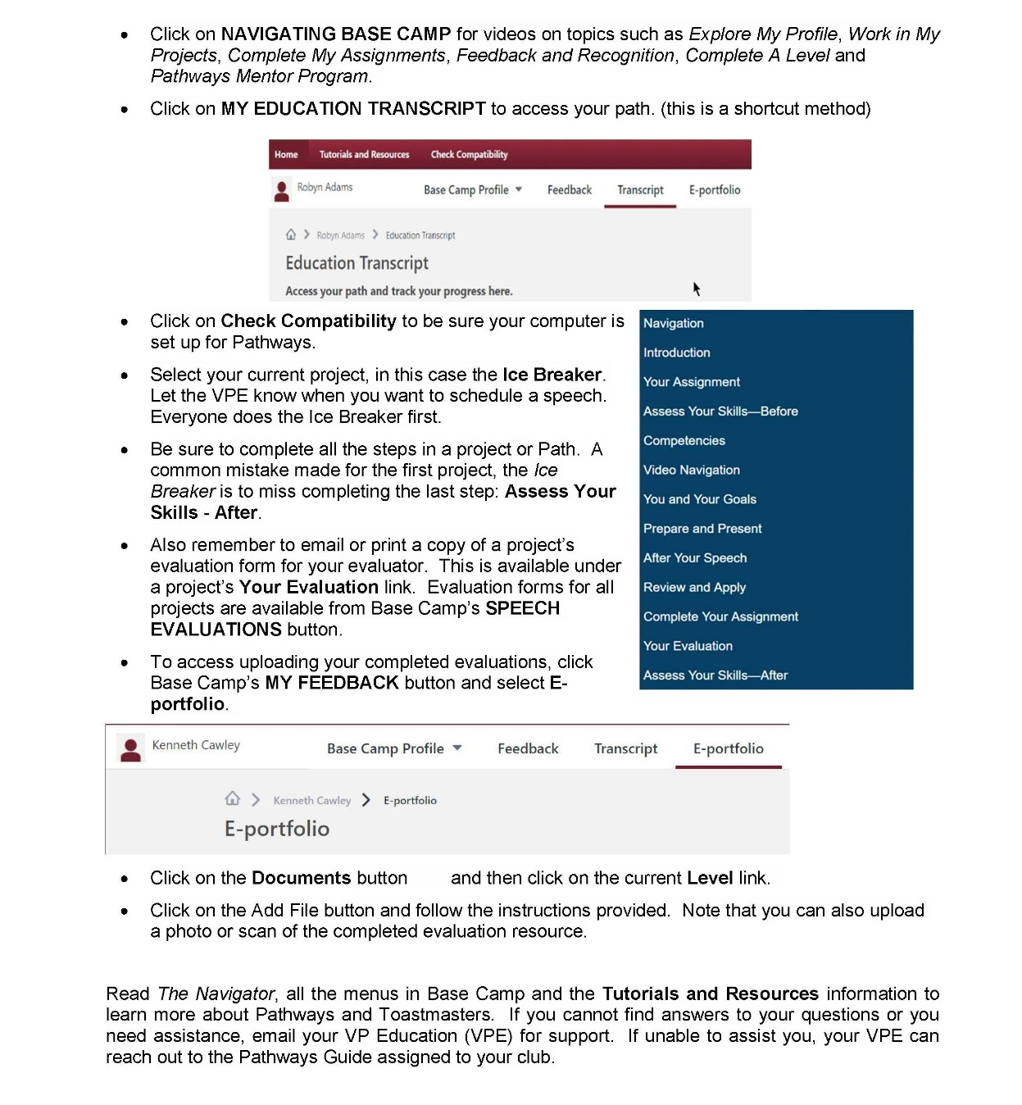

Slide 41
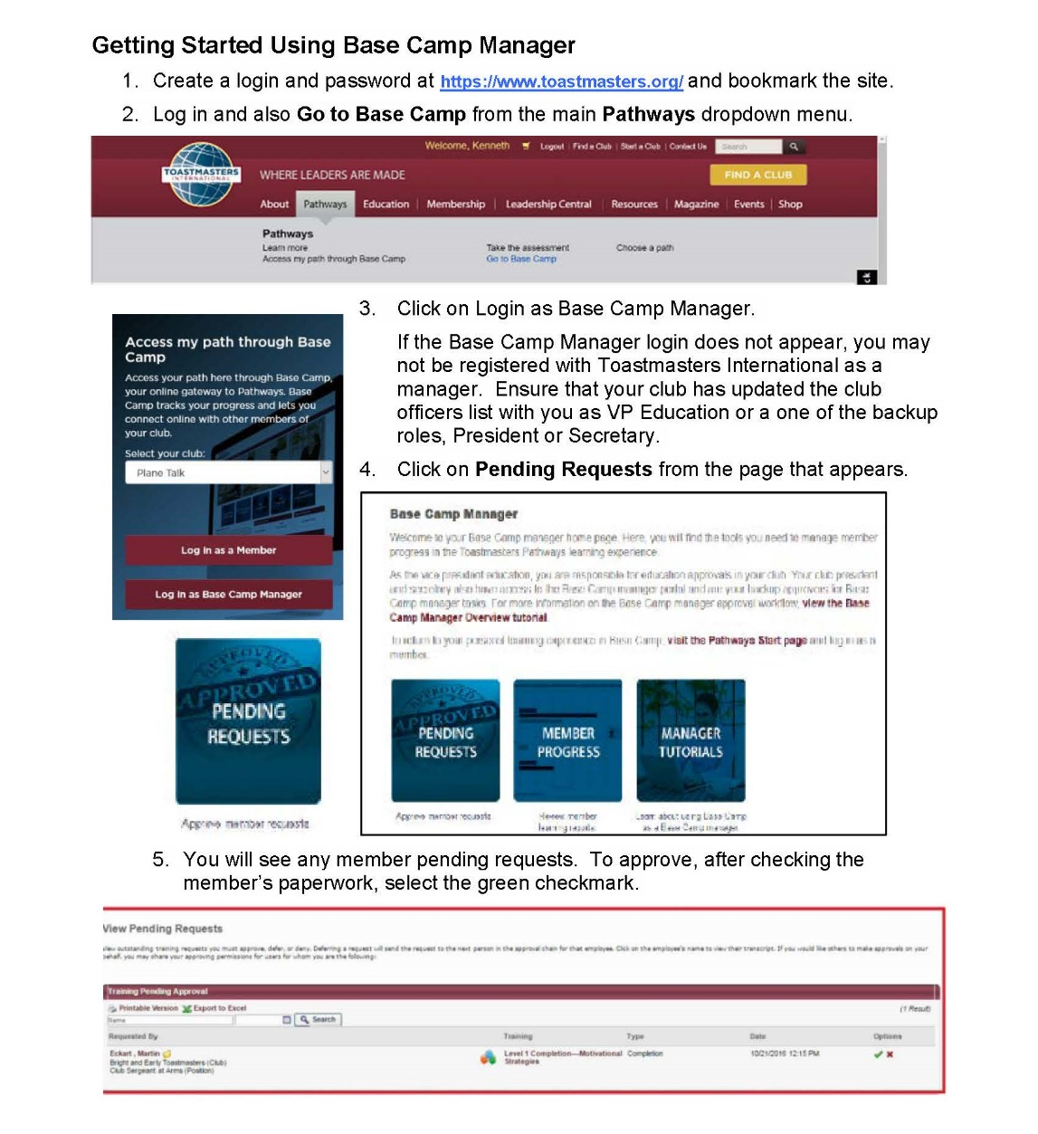
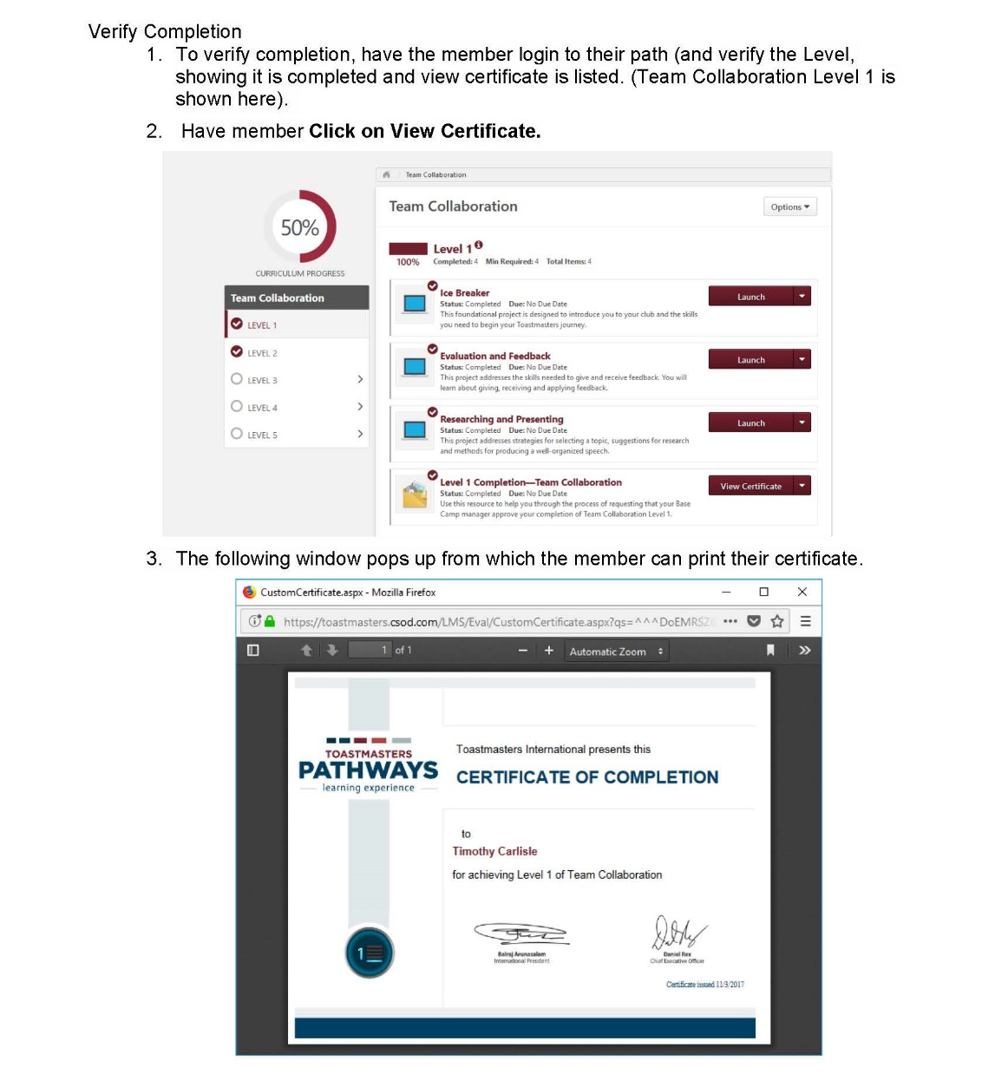
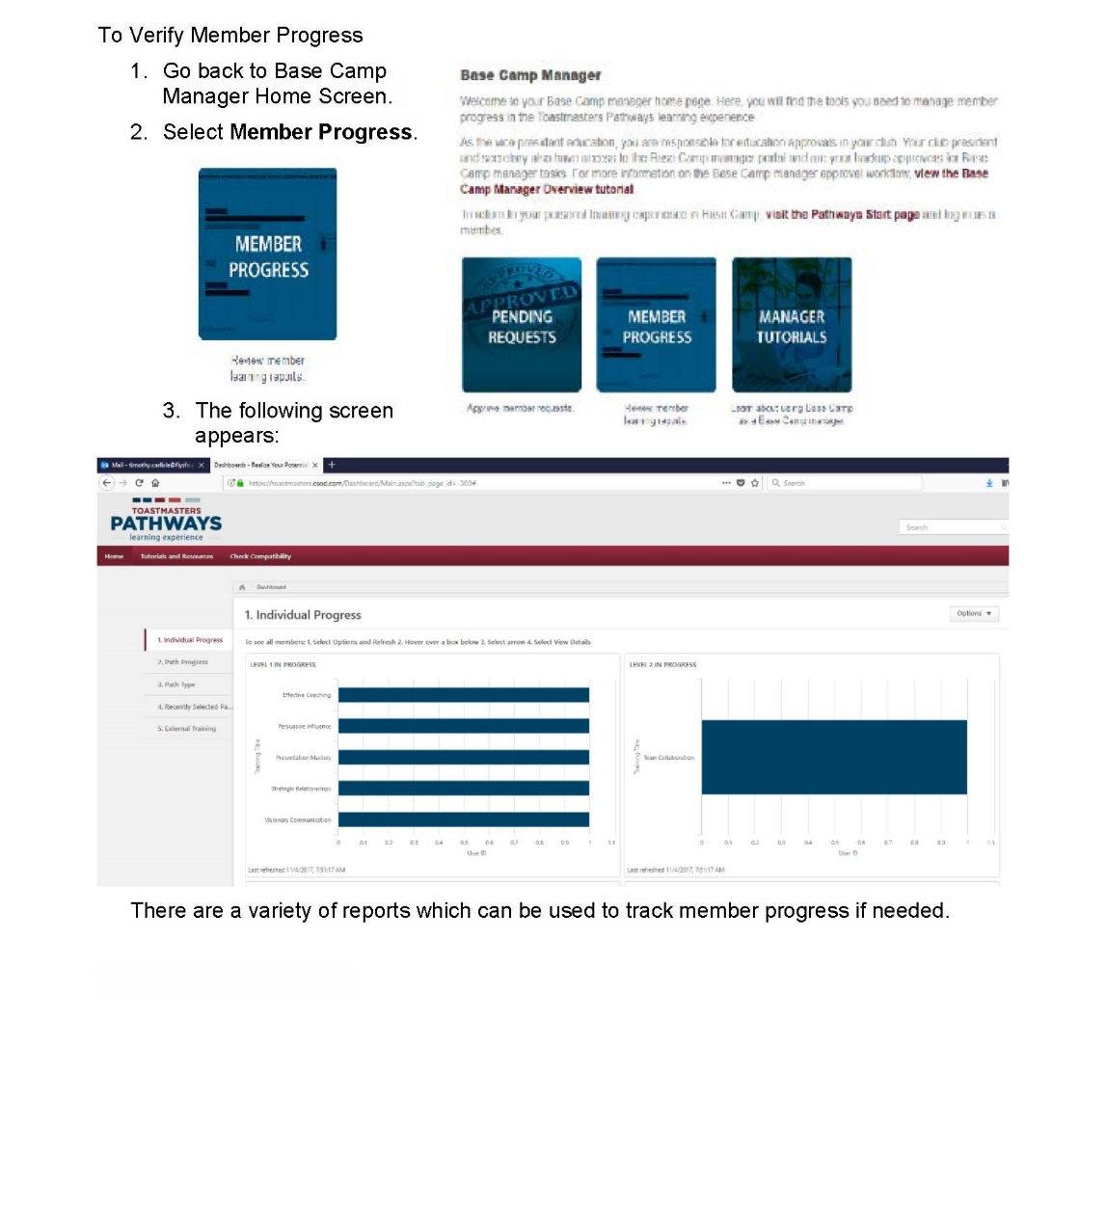
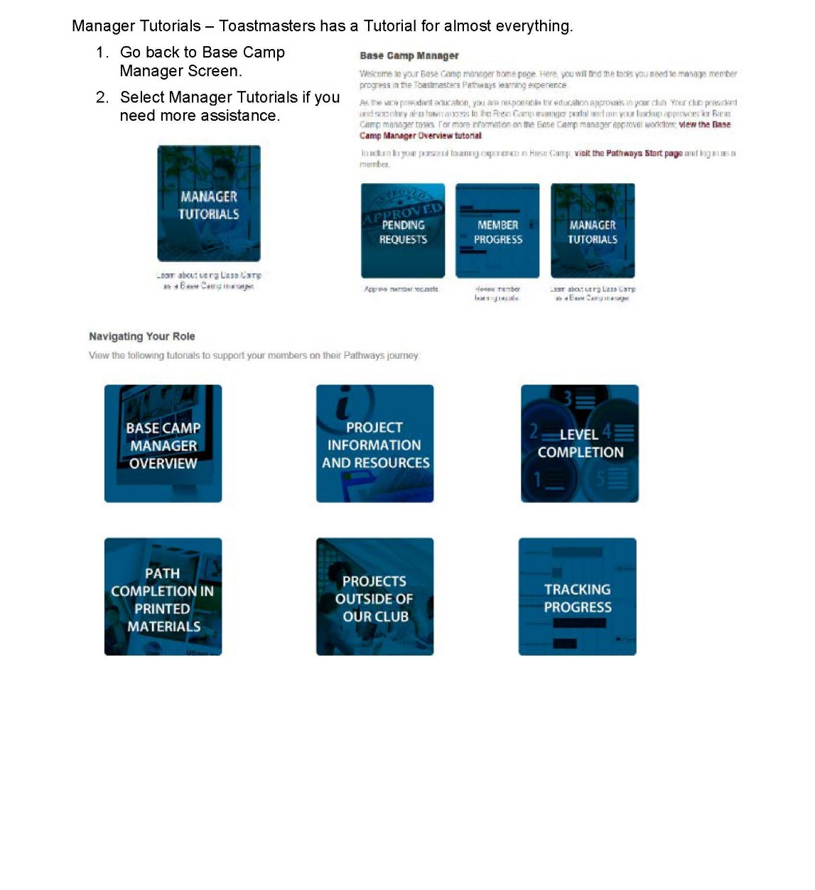

Slide 43
Base Camp Manager Duties
Responding to Level Completion Requests (Paths on Base Camp)
Printing Certificates (Paths on Base Camp)
Validating Project and Level Completion (Paths in Print)
Printing Certificates (Paths in Print)
Responding to Initial External Training Requests
Responding to External Training Completion Requests
Individual Progress Dashboard
Path Progress Dashboard
Path Type Dashboard
Recently Selected Paths Dashboard
External Training Dashboard

Slide 45
Questions

